Slide 1
S
T
E
M
Introduction To
Education

Slide 2
S
Science
T
What is STEM?
Technology
STEM is an acronym that stands for 4 education disciplines:
E
Engineering
M
Mathematics

Slide 3
With the inclusion of Arts, you may also see the acronym
S
T
E
A
M
These disciplines are increasingly emphasized within the education system to get students interested in higher education classes and careers that involve STEAM skills and knowledge.

Slide 4
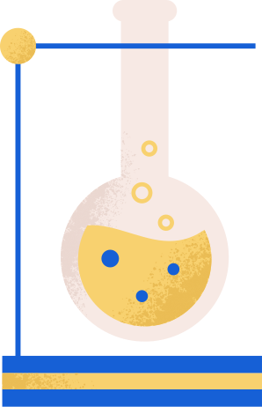
Why Study STEAM?
SCIENCE
Fields within science allow us to explore and understand the world around us through experimentation and research. It’s about discovery and possibility.

Slide 5

Why Study STEAM?
TECHNOLOGY
Almost any field you study will involve technology. It is constantly advancing, so there is always something new to learn. It has allowed us to connect with the world and access more information than ever before.

Slide 6

Why Study STEAM?
ENGINEERING
Engineers push the boundaries of science and solve technical problems. They enable everything from building structures to bioengineering to computer software. Innovation in this field plays a significant role in shaping our future.

Slide 7

Why Study STEAM?
ART
Art allows for creative expression through a variety of mediums. Students learn to construct, create, and describe different aesthetics. We can understand more about our culture and history through art.

Slide 8

Why Study STEAM?
MATHEMATICS
Math is the study of numbers, shapes, and logic. We use it every day, even in simple tasks, such as baking. It helps us understand patterns and analyze data.

Slide 9
Examples of STEAM Classes
SCIENCE
TECHNOLOGY
ENGINEERING
ART
MATHEMATICS
Chemistry
Oceanography
Astronomy
Anatomy
Genetics
Environment
Psychology
A.I.
Digital Media
Coding
App Development
Robotics
Mechanical
Aerospace
Computer
Electrical
Biomedical
Structural
Web Design
Graphic Design
Writing
Theater
Drawing
Painting
Photography
Statistics
Algebra
Geometry
Calculus

Slide 10
Benefits of STEAM Education
Critical Thinking
Creativity
Confidence
Collaboration/Teamwork
Curiosity
Innovation

Slide 11

Critical Thinking
Critical thinking allows students to observe, analyze, and understand when trying to solve complex problems. Using credible information and finding evidence to support arguments is imperative to learning and gaining knowledge.

Slide 12

Confidence
It’s great when everything goes right on the first try, but that is often not the case. Students should understand that failure is often a part of learning. To persevere through challenges brings better understanding, a sense of achievement, and confidence.

Slide 13

Curiosity
Curiosity involves asking questions and brainstorming different ideas to solve problems. It also inspires wonder, exploration, and imagination.

Slide 14

Creativity
Imagination and creative thinking are key to finding new ways to solve problems. Creativity allows students to break down a complex issue into smaller, more manageable tasks.

Slide 15

Collaboration/Teamwork
Working with others allows us to combine our knowledge and get immediate feedback to our ideas. We develop communication skills by working in groups toward a common goal. Collaboration also fosters discussion and team encouragement.

Slide 16

Innovation
Using experimentation, students can develop new ways of observing, analyzing, and solving complex problems. Innovation allows us to adapt to challenges and gain new insights.

Slide 17
Fascinating Careers in STEM/STEAM
Food Taster
Cryptozoologist
Marine Conservationist
Volcanologist
Urban Farmer
Cosmetic Scientist
Space Psychologist
Cave Diver
Firework Designer
Art Restorer
Museum Curator
3D Printing Engineer
Smart Cars/Cities Architect
Coder
Roller Coaster Engineer
Game Designer
Animator
Special Effects Technician
Robotics
Artificial Intelligence

Slide 18
References
Use this page to include any references you add to the presentation.

Slide 19
Resources
These are the elements used in the presentation. Feel free to add more and then delete this page before presenting.

